Slide 1
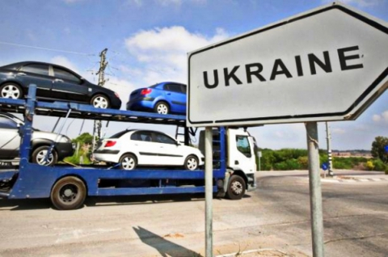
CAR SALES OPERATIONS IN UKRAINE
by Kishore Ohal

Slide 2
CAR SALES OPERATIONS IN UKRAINE
The survey was taken in Ukraine for used cars which enables the possibility to analyze features related to car operations.

Slide 3
CAR SALES OPERATIONS IN UKRAINE
This presentation has observations with each step in order to explain thoroughly how to approach the data set.
Based on the observation some questions also are answered in the presentation for the reference though not all of them are explored in the analysis.
I have taken into account the financial crisis faced by Ukraine
Ukraine government reduce the import duty
Government also made VAT changes that reduce taxes to the amount paid on resale profit, rather than on the entire value of the vehicle.
It help me create graphs based on Ukraine’s government policy

Slide 4
Data source and dataset
How was it collected?
Actual source from where the data was collected is unknown.
I received data from my data science Institution
Data has 9576 rows the data is collected till Year 2016.
Today in Nov 2018, the market conditions of Ukraine might differ.
It is a sample data
I don't have official information about the data collection method, but it appears not to be a random sample, so we can assume that it is not representative.

Slide 5
Packages and Library
Numpy and Pandas library available in python are used Analyze the data
The NumPy library is the core library for scientific computing in Python. It provides a high - performance multi-dimensional array , and tools for working with these arrays.
The Pandas library is built on NumPy and provides easy-to-use data structures and data analysis tools for the Python programming language.
Used seaborn and matplotlib packages
This packages are used to give visual representation to user about the data.

Slide 6
Pre Profiling
Profiling helps us understanding the data set
To gain insights from data I looked into each aspect of it very carefully.
I start with observing few rows and columns of data both from the starting till the end
I observed that data has 9 Columns and 9576 rows.

Slide 7
Columns in Dataset
Car – Contains Manufacturer’s name
Price – Price of car
body - different types of body like sedan, hatch, van etc
mileage – distance travelled
engV – 1.1lt, 1.2 lt etc
engType – Petrol , Diesel, Gas, others
registration – whether car is registered or not , i.e used or new
year - year of manufacture
model – sub model of car company, like GLE 250d, GLE350d etc
drive – front, rear, other

Slide 8
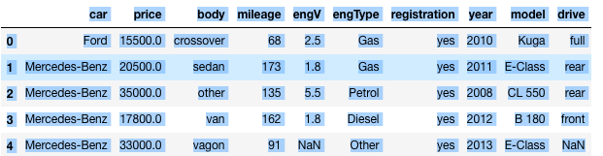
Sample Data Set

Slide 9
Pre Profiling Findings
The engV and Drive column count was less than other columns.
I check those column to check whether it has any NULL values.
The Min value of Car was 0. For the same we need to clean the data, as price can never be zero.
The Min value of mileage is 0 This shows us that the data set also has records for new car.
We can also see there are 87 unique types of car. We will only be concentrating on the Brands which has more records.

Slide 10
Data Clean Up
The engV and Drive column having null values is just 4 and 5 percent- I ignored those values
I removed the rows having price as 0.
After removing rows having price as zero, the data set now has 9309 rows

Slide 11
Data Post Profiling
I also did Post profiling and observe the data behavior.
It makes data clean without unwanted values

Slide 12
Questions
I Had asked questions to my self based on Ukraine condition in that period.

Slide 13
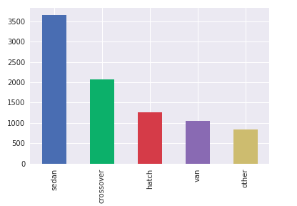
What is count of different body types of car
Observations
Sedan is preferred by customers followed by crossover.
Sedan is that type which is not too small and not too large.
Hence, many would prefer the same

Slide 14
who are the different manufacturers of car
'Ford', 'Mercedes-Benz', 'Nissan', 'Honda', 'Renault', 'BMW', 'Volkswagen', 'Audi', 'Chrysler', 'Jaguar', 'Mitsubishi', 'Kia', 'Porsche', 'Toyota', 'Hyundai', 'Opel', 'Chevrolet', 'Skoda', 'Land Rover', 'Daewoo', 'Mazda', 'Lexus', 'Infiniti', 'Tesla', 'Subaru', 'VAZ', 'Alfa Romeo', 'Smart', 'Peugeot', 'Suzuki', 'Chery', 'Bentley', 'Volvo', 'SsangYong', 'Fiat', 'ZAZ', 'Citroen', 'Dodge', 'Jeep', 'Great Wall', 'Seat', 'MINI', 'Dacia', 'Hummer', 'Geely', 'Maserati', 'BYD', 'Cadillac', 'Acura', 'Aston Martin', 'Rover', 'GAZ', 'GMC', 'Lincoln', 'Moskvich-AZLK', 'FAW', 'UAZ', 'ËUAZ', 'TATA', 'ZX', 'Lifan', 'Mercury', 'Groz', 'Moskvich-Izh', 'Saab', 'Lancia', 'Aro', 'Ferrari', 'Isuzu', 'Bogdan', 'Dadi', 'Rolls-Royce', 'Other-Retro', 'MG', 'Samand', 'JAC', 'Samsung', 'Lamborghini', 'Daihatsu', 'Hafei', 'SMA', 'Changan', 'Barkas', 'Huanghai', 'Wartburg', 'Buick’
We have seen there are 87 unique car manufacturers in Ukraine.

Slide 15
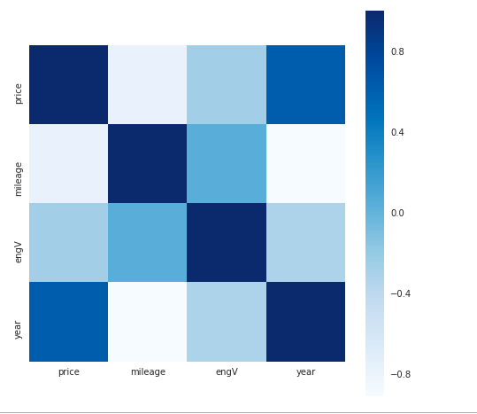
Correlation of Features
From the above Correlation
- Price and Mileage are negatively corelated.
-Price and Year are Positively corelated.
Which States that
As Mileage of the Car increases the Price Decreases
Also, Less The Number of Years car is used More is the Price

Slide 16
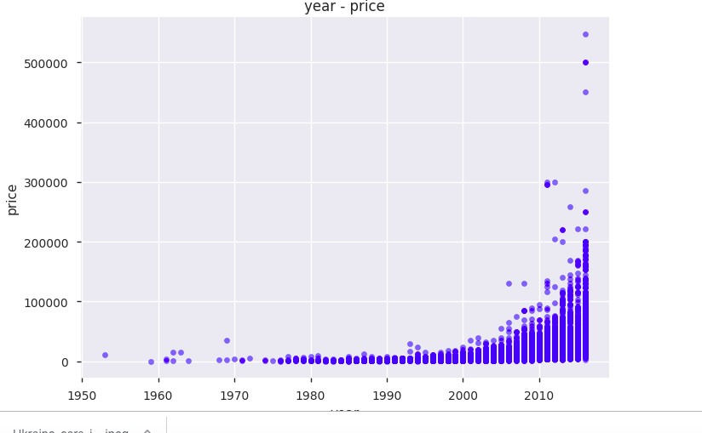
Price Behavior vs Year
We can observe that price of cars were within below range until 2005
- Then there is a little steep in price till 2013
- But after 2013 we can see big rise in car price.
We can assume that until 2005 users were buying cars from there country.
After 2013 since the import duty was decrease users purchased imported used cars.

Slide 17
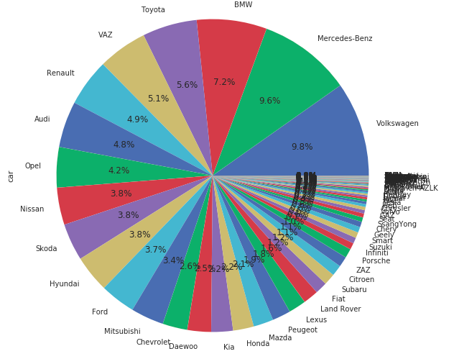
Percentage of Car Manufacturers sold in Ukraine
Volkswagen tops the list in car sales, followed by Mercedes-Benz, BMW

Slide 18
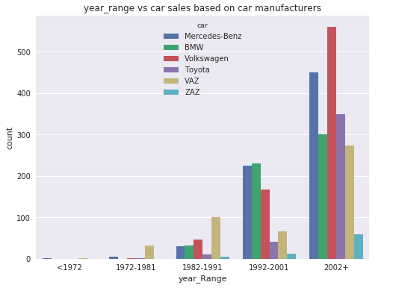
Count of Car Manufacturers sold in Ukraine in duration of ten years each
1. Before 1972 there was not much car sales
2. Volkswagen which tops the car sales in Ukraine can be seen was 3 bfore 2001 but it increased its sale after 2002
3. Seems like Volkswagen have gain trust in Ukraine
4. Even VAZ - The Russia firm which was top seller till 1991 drop down considerably after 2002. This may be due to reduce import duty
5. As you can see ZAZ- the domestic manufacturer has lowest sales every time

Slide 19
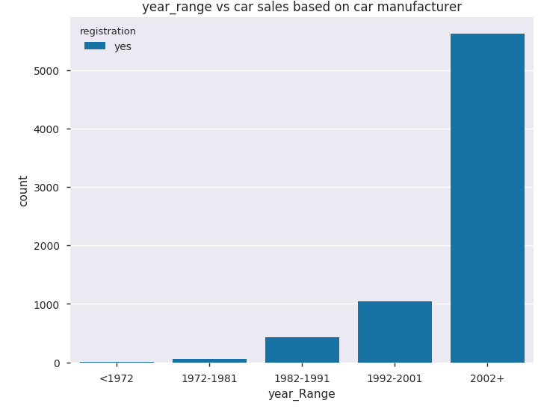
Count of Car Registered in each decade
1. before 1972 there was not much car sales
2. The last decade after 2002+ car sales increased considerably

Slide 20
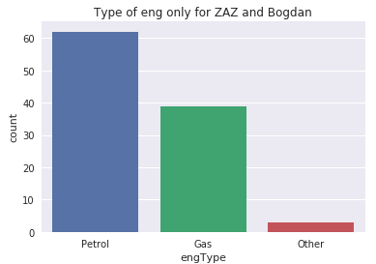
Count of which eng type car is sold by Ukraine's car manufacturer
For car Manufactured in Ukraine, doesn't sell Diesel cars

Slide 21
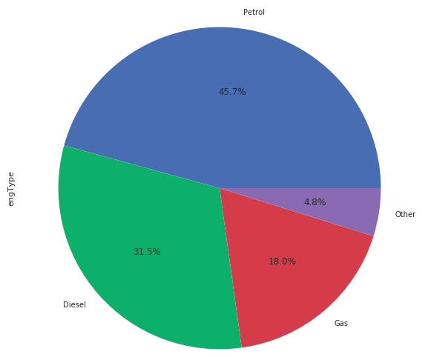
Which eng type is sold most
Petrol cars are sold most in Ukraine followed by diesel and gas

Slide 22
Pair plot to know the joint relationship between 'Mileage','Price','Eng type', 'Registration' and 'Year'

Slide 23
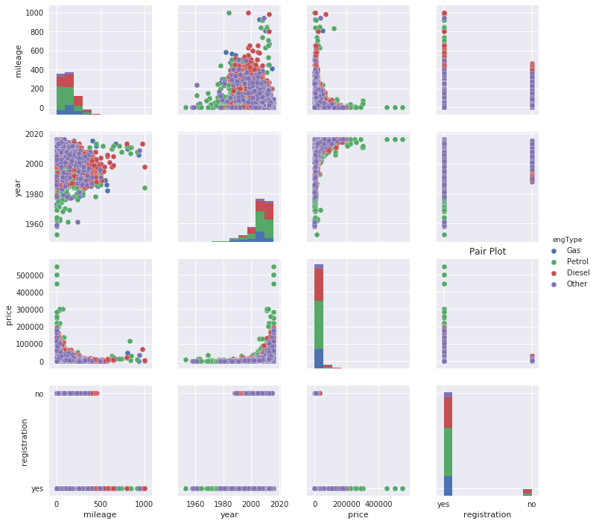

Slide 24
Pair plot Observation
Mileage of Diesel run cars are more than petrol - It means consumers prefer Diesel Car, as it is cheaper than petrol and has a better average.
- Also, you can see the petrol cars are sold more quickly - Since, in registration equals no we see no petrol cars
- Price of petrol car is more as compare to other engine types - But it depends on manufacturer segment.
- When Mileage is Less Price is more - In that too petrol car price is more than other eng types
- Before 1960 till 1980 not much cars were sold
- All the cars before 1985 are registered.
- From 1980 to 2000 car purchased increased
- from 2000 onwards we see sudden increase in car sales that too of diesel types.
- towards the end of 2016 again there is little drop in car sales may be due to financial crisis in Ukraine
- Also, from other pair plot you can see the price of cars has increased a lot towards the end

Slide 25
Conclusion
You can see data has more number of Old Cars than new cars.
Seems like people in Ukraine buy less Cars manufactured in Ukraine because of reduce import duty
Also, they prefer more of European cars than Asian manufactures.

Slide 26
Conclusion
By Olena Savchuk. Published March 31, 2016 at 11:33 pm Meanwhile, Ukrainian used car sales and revenues are mainly in the shadows. Importers of new cars pay 30-50 percent of a vehicle’s market price in duties to the budget. A second-hand car importer pays only 10-15 percent of a car’s value to the state, using various schemes to minimize VAT and import duties, Borovik said

Slide 27
Conclusion
Sedan is preferred by customers followed by crossover
We can assume that until 2005 users were buying cars from there country. After 2013 since the import duty was decrease users purchased imported used cars
for the survey taken Volkswagen tops the list in car sales, followed by Mercedes-Benz, BMW

Slide 28
Conclusion
Taken from Ukraine press site - "VAT changes that reduce taxes to the amount paid on resale profit, rather than on the entire value of the vehicle." increased the sales of used car more.
Taken from Ukraine press site "Ukraine’s automobile industry lost its competitiveness after Ukraine joined the World Trade Organization and import duty on automobiles fell from 25 to 10 percent.”
Taken from Ukraine press site - "Imports of foreign used cars jumped immediately after import duties were cut." from section:

Slide 29
Conclusion
We can say that car sales of own country has reduced in Ukraine because of the reduce import duty for imported cars and VAT policy for used imported cars.
Also, Price of the car depends on mileage and year of purchase

Slide 30
THANK YOU
BY
CAR SALES OPERATIONS IN UKRAINE
by Kishore Ohal

